Slide 1
VMTS DE Project Overview -VMTS Infosys
Engineering Services, Infosys
Feb 2017

Slide 2
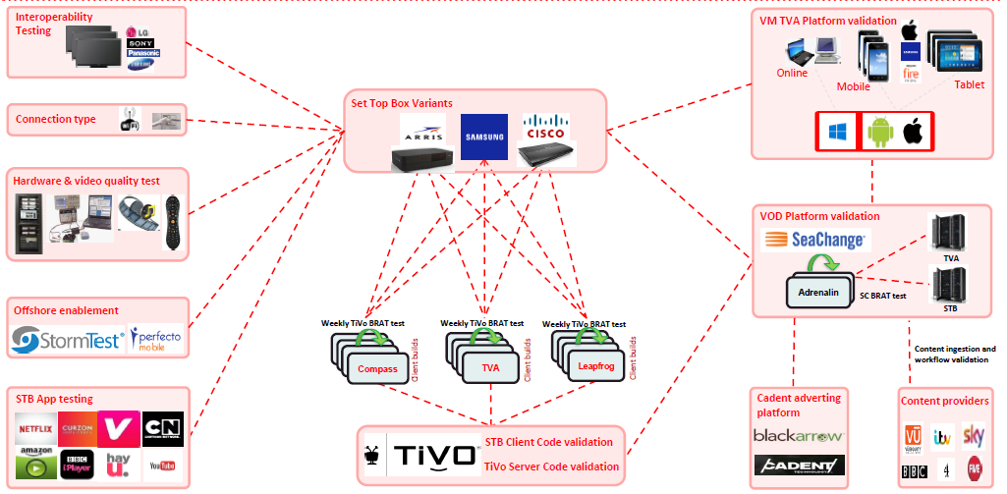
Overview

Slide 3
VMTS DE – CTO and CIO scope
VMTS Functional test scope in Digital Entertainment has been defined to cover components and architecture that are categorised as both CIO and CTO.
-CTO scope covers testing of:
•Legacy and TiVo Software features on physical Set Top Boxes and Mobile devices.
•Content management systems
-CIO scope covers testing of:
•Provisioning, authentication and authorisation flows.
•Validation of the E2E BSS/OSS journey involving components such ICOMS, DPE, Sigma, CLDAP, SCV, etc.
•Non-functional Testing i.e. Data testing, Performance testing of IT stack, security testing

Slide 4
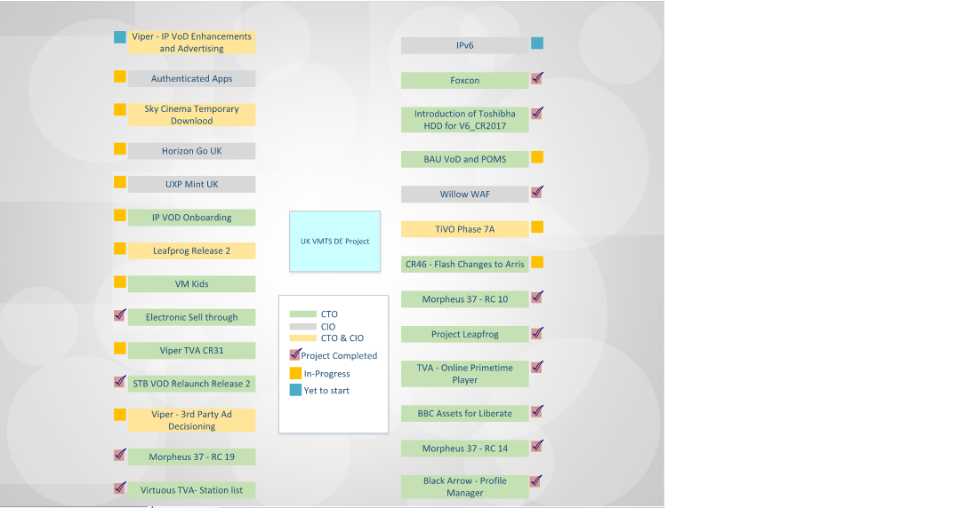
Project Scope

Slide 5
IP VoD Onboarding
This project is a placeholder, for multiple Content Providers on-boarding activity.
CPs which have IP content are on-boarded .
BAU VoD project takes care of content level validation for existing non-IP CPs.
IP VoD Onboarding solutions are Harmonic and VSPP .
In-Scope : Functional Testing(Metadata & Encoding Validation)
Out-of-Scope : Non-Functional Testing
Hardware In-Scope : Leapfrog and compass STB boxes
Interrelated Project : Viper IP VoD Enhancement & Ad.
Scope : CTO
Status : In Progress

Slide 6
Viper - IP VoD Enhancements and Advertising
This project is about enabling IP VoD Advertisements.
IPVod Onboarding project currently support harmonic packaging.
VSPP supports pre, post and mid roll.
Harmonic supports only pre and post ad streaming.
In-Scope : Functional Testing(Metadata & Encoding Validation)
Out-of-Scope : Non-Functional Testing
Hardware In-Scope : Leapfrog and compass STB boxes
Interrelated Project : IP VoD Onboarding
Scope : CTO & CIO
Status : Yet to Start

Slide 7
BAU VoD and POMS
Business As Usual is a small project where any fixes and effort related to the content/Ad Changes falls.
This is not a standalone project , but more of a placeholder for changes related to the Content or Ad related fixes.
The main focus of this project is to verify the various content types like validation of metadata and encoding.
Virgin Media has a VoD platform which will be used to ingest the content or to play advertisements.
Tickets needs to be raised with environment team to ingest the data.
Once the asset is ingested, testing team will check the content by using a VoD UI on the STB
POM’s a monthly drop to change the folder structure of VoD Catalogue seen on Set Top Boxes.
For example, highlighting a movie or a series in order to increase the sales of VoD content.
Scope : CTO
Status : In Progress

Slide 8
Sky Cinema Temporary Download
Scope : CTO & CIO
Status : In Progress

Slide 9
Leapfrog Release 2
Project Leapfrog Release – 2 is based on the Arris V6 Boxes which are currently deployed in field as part of Release 1.
V6 Boxes should be compliant with EU regulations for power consumption in different power saving modes.
In Scope : Regression testing , Stress Testing , UI Performance Testing and Soak Testing .
Out-of-Scope : EU Compliance testing for power consumption of STBs in different power saving modes .
Interrelated Project : Introduction of Toshiba HDD for V6 & Foxconn
Scope : CTO & CIO
Status : In Progress

Slide 10
Foxconn
Manufacturing of Arris V6 boxes shifted from in Taiwan to Foxconn office at China.
New Arris V6 boxes have changes in Hardware Components .
Testing scope was to make sure that no functionalities were broken due to the changes.
In Scope : Regression testing , Stress Testing , UI Performance Testing and Soak Testing.
Out-of-Scope : EU Compliance testing for power consumption of STBs in different power saving modes .
Interrelated Project : Introduction of Toshiba HDD for V6 & Leapfrog Release 2
Scope : CTO
Status : Completed

Slide 11
Introduction of Toshiba HDD for V6_CR2017
Western Digital (WD) used to providing the Hard disks for Arris V6 boxes .
Later VM on boarded Toshiba as their new Hard disk provider .
Testing scope was to make sure that no functionalities were broken because of new hard disk from Toshiba.
In Scope : Regression testing , Stress Testing , UI Performance Testing and Soak Testing .
Out-of-Scope : EU Compliance testing for power consumption of STBs in different power saving modes
Interrelated Project : Foxconn & Leapfrog Release 2
Scope : CTO
Status : Completed

Slide 12
VM Kids
The scope of this project was to introduce Kids centric applications each for android and iOS platforms.
The applications is developed and hosted by Vubiquity.
Vubiquity will release build after bug fixing.
In – Scope : Functional and Regression testing
Scope : CTO
Status : In Progress

Slide 13
Electronic Sell through
Virgin Media has launched the Virgin media store – a new electronic sell-through proposition
Introduces brand new website, apps on mobiles and apps on STB.
Testing scope is to test Entire portal and STB.
No dependency on CIO
Scope : CTO
Status : Completed

Slide 14
Viper TVA CR31
Companion application which enables customer to view services on web/mobile devices.
VMTS do application end-to-end testing across mobile devices, web and STB.
It’s related to application testing.
MRS
Scope : CTO
Status : In Progress

Slide 15
STB VoD Relaunch Release 2
Scope : CTO
Status : Completed

Slide 16
Viper - 3rd Party Ad Decisioning
Scope : CTO & CIO
Status : In Progress

Slide 17
CR46 – Flash changes to Arris
Scope : CTO
Status : In Progress

Slide 18
Project Leapfrog
Scope : CTO
Status : Completed

Slide 19
TVA – Online Primetime Player
Scope : CTO
Status : Completed

Slide 20
BBC Assets for Liberate
Scope : CTO
Status : Completed

Slide 21
Black Arrow - Profile Manager
Scope : CTO
Status : Completed

Slide 22
Morpheus 37 – RC19
Scope : CTO
Status : Completed

Slide 23
Morpheus 37 – RC10
Scope : CTO
Status : Completed

Slide 24
TiVo Phase 7A
Scope : CTO & CIO
Status : In Progress

Slide 25
TiVo Phase 7B
Scope : TBD
Status : Yet to Start

Slide 26
Vendors

Slide 27
Platforms

Slide 28
Tools/Technologies

